Slide 1
Personalised Product Search on JDSearch
A Dual-Horizon Re-Ranker Driven by Log-Retention Dynamics
BT4222 Final Project · Group 13 · Prof. Wang Qiuhong

Slide 2
The Problem: Personalised Re-Ranking
• Business goal: shorten search→purchase by re-ranking each query's candidate slate
• Input: current query + product metadata + user's multi-behaviour history
• Label (ordinal): 0 none / 1 click / 2 cart / 3 purchase
• Metrics: NDCG@10, MRR@200, Precision@1
• 173,831 users · 15.5M query–candidate pairs · 26.7M interactions
  – Hard: 97.9% of candidates are negative; 80.5% of products are cold

Slide 3
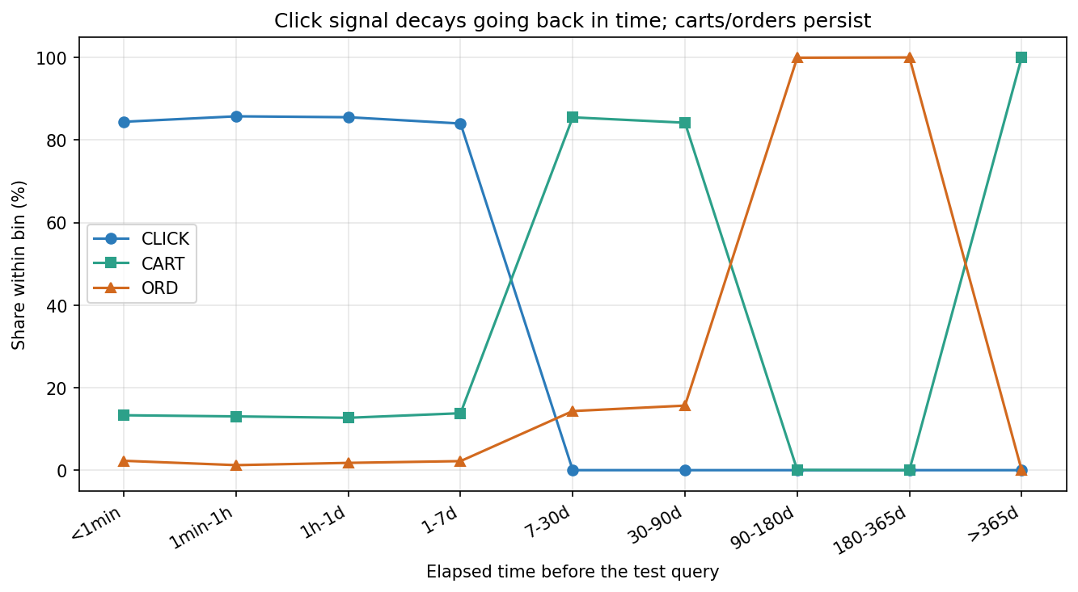
A Data Anomaly Worth Chasing
• Normal e-commerce funnel: clicks ≫ carts ≫ orders
• JDSearch history: CART 43% > CLICK 31% > ORD 26%
• Millions of orders & carts have NO clicks at all
  – Instructor's prompt: trace the timeline back in days — what happens to the mix?

Slide 4
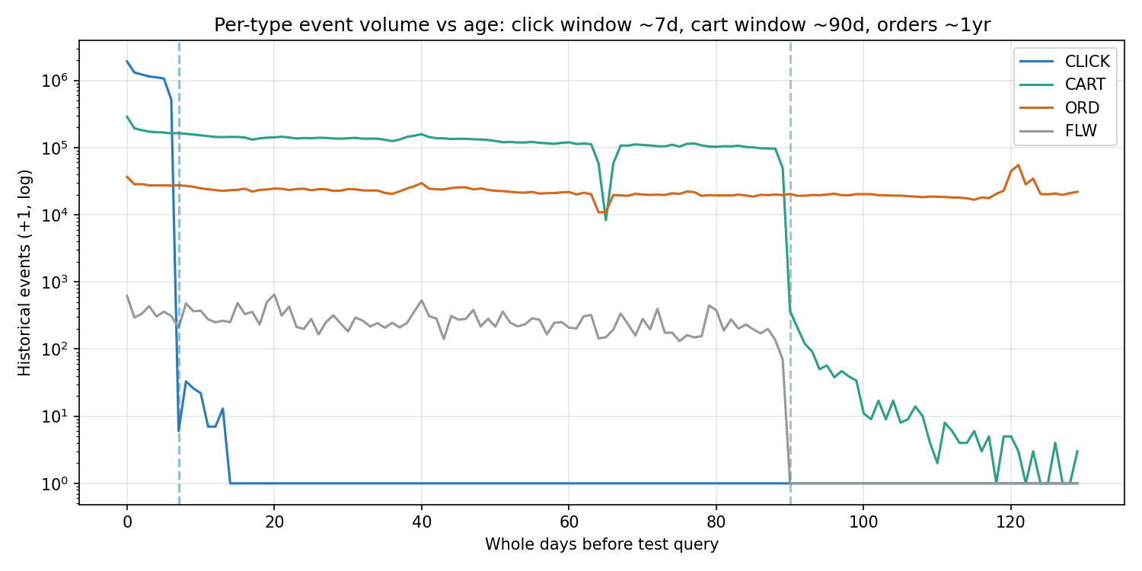
Key Finding: a Telescoping Log-Retention Window
• Clicks retained ~7 days (day6: 520,760 → day7: 5)
• Carts retained ~90 days (day85: 100,902 → day90: 365)
• Orders retained ≥1 year
• ⇒ interaction TYPE is confounded with RECENCY, not intensity
  – The 'carts/orders > clicks' anomaly = long tail where only durable signals survive

Slide 5
From Insight to Feature Engineering
• Do NOT weight ORD>CART>CLICK as intent — it just encodes old vs recent
• Absence of old clicks is a logging artifact, not a negative
• Distinct roles of fields:
  – Recent clicks/carts (≤7–90d) → short-term query INTENT
  – Old orders (≤1yr) → long-term brand/category PREFERENCE
• Engineered: horizon-split category/brand affinity, recency-decay, re-engagement
• Reality check: anonymised query↔name overlap alone ≈ random (0.087)

Slide 6
Baseline Gap: Why CF Fails Here
• Each user = one record with an almost-always-new query
• 80.5% of products never appear in any history (14.5% warm on test)
• NCF (ID-based) → NDCG@10 0.086 ≈ random (0.083)
• SVD/NMF only reaches popularity level (0.274)
  – Gap = new-query generalisation under massive item cold-start

Slide 7
Our Model: Dual-Horizon Attention Ranker (DHAR)
• Candidate category/brand embedding = attention query
• Tower A: attends over RECENT (≤7d) history categories → short intent
• Tower B: attends over ORDER-history categories → long preference
• Fuse [cand ⊕ short ⊕ long ⊕ engineered feats] → MLP
• Listwise softmax with ordinal gains [0,1,3,7]; trained on Apple MPS
  – Architecture = direct materialisation of the two retention horizons

Slide 8
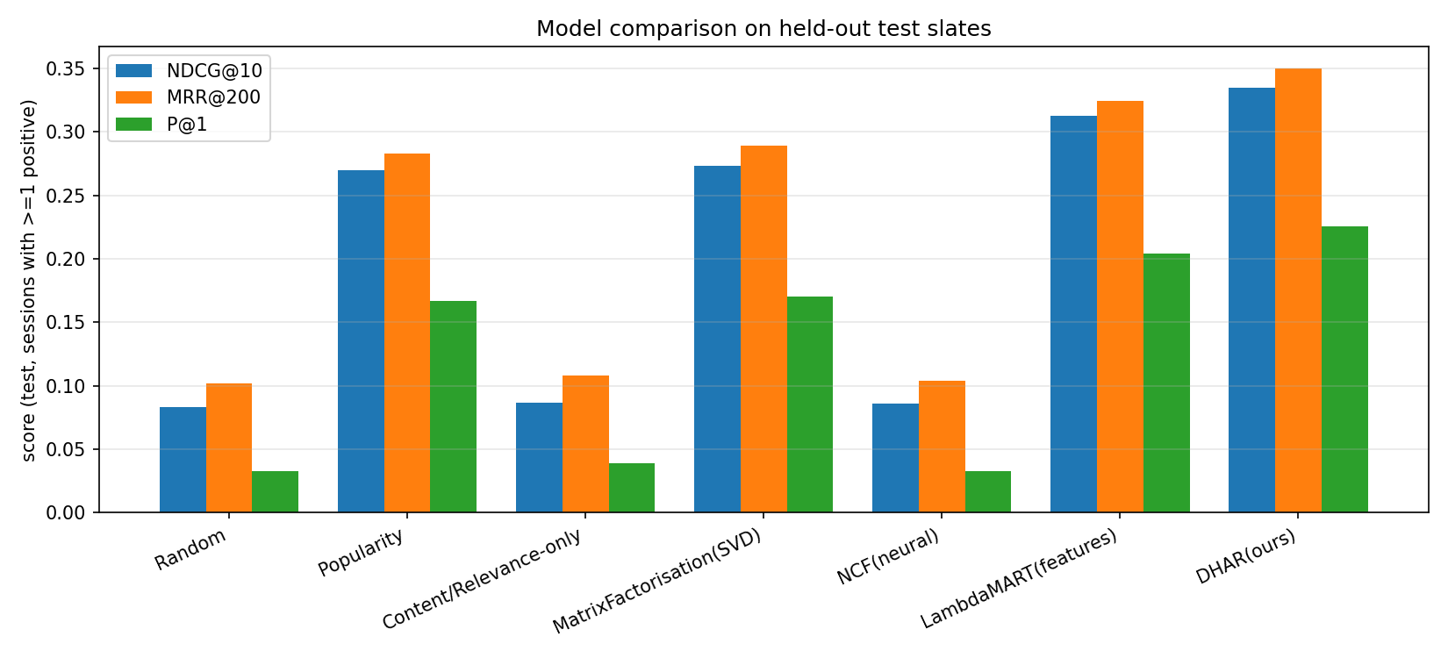
Results (held-out test slates)
Model | NDCG@10 | MRR@200 | P@1
Random | 0.083 | 0.102 | 0.033
NCF (ID-CF) | 0.086 | 0.104 | 0.032
Popularity | 0.270 | 0.283 | 0.167
MatrixFact (SVD) | 0.274 | 0.289 | 0.170
LambdaMART | 0.313 | 0.325 | 0.204
DHAR (ours) | 0.335 | 0.350 | 0.225

Slide 9
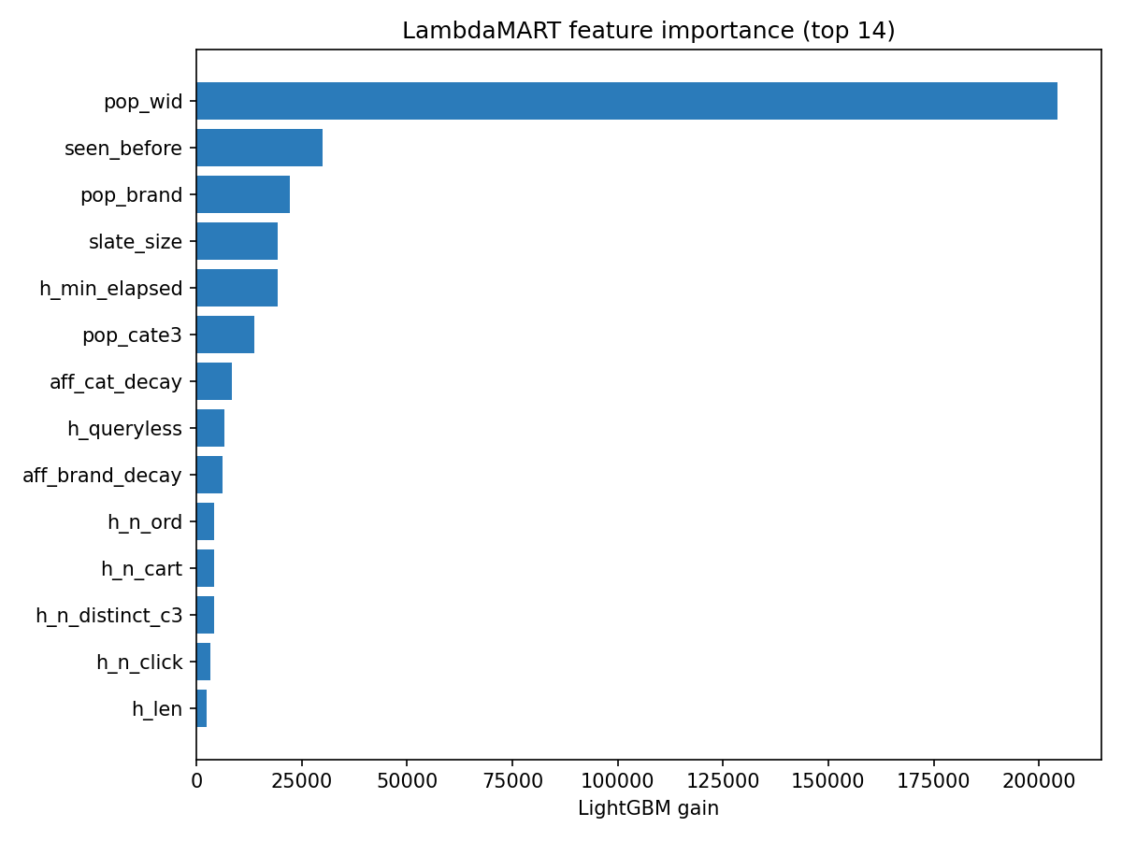
Diagnostics Validate the Hypothesis
• Rank of eventual positives (lower=better):
  – Purchase median 7 < Cart 15 < Click 26
  – Model ranks purchases best — they align with long-term order signal
• Warm vs cold candidate: NDCG 0.586 vs 0.180
  – Cold-product ceiling is THE binding limitation
• Ablation: temporal-aware features add +0.013 NDCG@10

Slide 10
Business Insights & Conclusion
• A data-collection artifact (retention windows) reshaped our entire model design
• Separating short-term intent from long-term preference beats CF, popularity & GBM
• Purchase-oriented ranking should use the long-horizon tower; CTR-oriented, the short one
• Biggest lever = content representations for cold products (0.586→0.180 gap)
• Reproducible pipeline scales from 20k-user laptop run to full data via one knob

